Slide 1
Machine Learning
Presenter :
Sudhanshu Gupta
BSP SW Team

Slide 2
Agenda
1.1 Introduction to Machine Learning
1.2 TBGEN Block Diagram
1.3 TBGEN Event Connectivity

Slide 3
Machine Learning Algo
Supervised Learning
Un-supervised Learning
Reinforcement Learning
Recommender Systems

Slide 4
Definition
A computer program is said to learn from experience “E” with resepect to some class of tasks “T” and performance measure “P” , if its performance at task “T”, as measured by “P”, improves with experience “E”
-- Tom Mitchell
Task
T
P
E
Performance
Experience

Slide 5
Supervised Learning (Problem Types)
Regression Problem - To predict Continuous Values
Classification Problem – To predict Discrete Values

Slide 6
Supervised Learning
Supervised Learning Problem Types :
Regression Problem - To predict Continuous Values
Classification Problem – To predict Discrete Values
Supervised learning problems are categorized into "regression" and "classification" problems.
In a regression problem, we are trying to predict results within a continuous output, meaning that we are trying to map input variables to some continuous function.
In a classification problem, we are instead trying to predict results in a discrete output. In other words, we are trying to map input variables into discrete categories.
Example 1:
Given data about the size of houses on the real estate market, try to predict their price. Price as a function of size is a continuous output, so this is a regression problem.
We could turn this example into a classification problem by instead making our output about whether the house "sells for more or less than the asking price." Here we are classifying the houses based on price into two discrete categories.
Example 2:
(a) Regression - Given a picture of a person, we have to predict their age on the basis of the given picture
(b) Classification - Given a patient with a tumor, we have to predict whether the tumor is malignant or benign.

Slide 7
UnSupervised Learning
Unsupervised learning allows us to approach problems with little or no idea what our results should look like. We can derive structure from data where we don't necessarily know the effect of the variables.
We can derive this structure by clustering the data based on relationships among the variables in the data.
With unsupervised learning there is no feedback based on the prediction results.
Example:
Clustering: Take a collection of 1,000,000 different genes, and find a way to automatically group these genes into groups that are somehow similar or related by different variables, such as lifespan, location, roles, and so on.
Non-clustering: The "Cocktail Party Algorithm", allows you to find structure in a chaotic environment. (i.e. identifying individual voices and music from a mesh of sounds at a cocktail party).

Slide 8
Linear Regression with One Variable Model & Cost Function

Slide 9
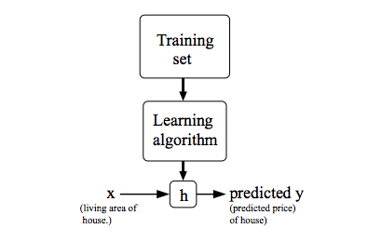
Model Representation
To establish notation for future use, we’ll use x(i) to denote the “input” variables (living area in this example), also called input features,
and y^{(i)}y(i) to denote the “output” or target variable that we are trying to predict (price).
A pair (x ^{(i)} , y^{(i)} ) is called a training example, and the dataset that we’ll be using to learn—a list of m training examples is called a training set.
Note that the superscript “(i)” in the notation is simply an index into the training set, and has nothing to do with exponentiation. We will also use X to denote the space of input values, and Y to denote the space of output values. In this example, X = Y = ℝ.
To describe the supervised learning problem slightly more formally, our goal is, given a training set, to learn a function h : X → Y so that h(x) is a “good” predictor for the corresponding value of y.
For historical reasons, this function h is called a hypothesis.
When the target variable that we’re trying to predict is continuous, we call the learning problem a regression problem.
When y can take on only a small number of discrete values (such as if, given the living area, we wanted to predict if a dwelling is a house or an apartment, say), we call it a classification problem.
hypothesis

Slide 10

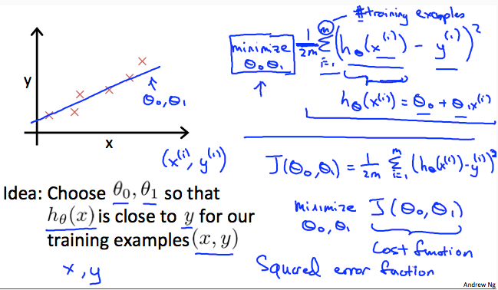
Cost Function
We can measure the accuracy of our hypothesis function by using a cost function. This takes an average difference (actually a fancier version of an average) of all the results of the hypothesis with inputs from x's and the actual output y's.
This function is otherwise called the
"Squared error function", or "Mean squared error".

Slide 11
Cost Function - Intuition 1
We can measure the accuracy of our hypothesis function by using a cost function. This takes an average difference (actually a fancier version of an average) of all the results of the hypothesis with inputs from x's and the actual output y's.

Slide 15
Programing Environment / Tools
Octave
Matlab

Slide 16
Q n A

Slide 17
Backup Slides

Slide 18
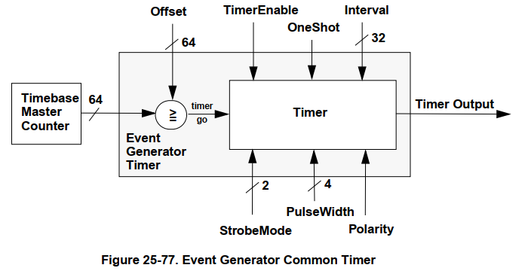
Functional Description
Timebase Event Generator
Timer generates its first event when the 64-bit timebase master counter value is greater than or equal to the offset value programmed for the timer.
The output event of the timer can occur once (one-shot mode), or repeat in a periodic fashion.
In one-shot mode, the timer fires once and goes to sleep.
In the repeating, periodic mode, the timer output event will fire repeatedly.
INTERVAL[31:0] : number of reference clock cycles between output events.
STRBMODE[1:0] : configure the type of output event. Output events can be configured to be a
Pulse (of programmable width)
In pulse mode, the width of the output pulse is configured with the PULSEWIDTH[3:0] bits and can be set to be between 1 and 16 reference clock cycles wide.
a simple toggle, or
an approximate 50% duty cycle pulse.

Slide 19
Functional Description
Timebase Master Counter Unit (TMCU)
Master Counter
Master Counter is a 64-bit counter which is used to keep track of the system timing.
It is fed by the Timebase Reference Clock and is initialized to zero out of system reset or cleared by software reset.
The Master Counter will be running as soon as the Timebase Reference Clock is available and will not rollover within 500 years if left running continuously.
Last 10ms Master Counter Register
Timebase Counter unit has a Last 10ms Master Counter (TS10MSHI and TS10MSLO) register which stores the value of the master counter of the last 10 ms frame.

Slide 20
Functional Description
Control Sequence Generator
Tx/Rx Switching Modes
TbGEN has the hardware mechanism to individually drive the Tx_enable and Rx_enable signals for up to 8 transceivers.
The TX and RX enables can be driven manually by software using the TDDx_CTRL(TXRXEN[1:0]) bits, or in a programmable sequential fashion.
TDD switching unit contains 8 timers to control up to 8 transceivers. Each timer can be programmed to output a sequence of up to 16 steps. Each of the 16 steps in the sequence have a programmable duration and a programmable TX/RX Enable output value.
Duration of each step is programmed by writing a value to the TDDx_DURATIONx(DURATIONx[31:0]) bits of the register associated with the timer and sequence step. TDDx_DURATIONx(DURATIONx[31:0]) bits represents the number of reference clock cycles for the given step in the sequence.
TDDx_MODE(MODEx[1:0]) bits determine the value of the TX/RX enable outputs for the associated step in the sequence. The length of the sequence can be configured to be between 1 and 16 steps. The sequence starts when the Timebase Master Counter value is greater than or equal to the programmed offset for the TDD Switching Unit timer.
If the TDD switching unit timer is configured for continuous sequencing, the timer will execute the number of sequence steps defined by the TDDx_CTRL(BUFLENGTH[3:0]) bits and then immediately repeat the sequence of steps, starting with step 0. Sequencing will continue until the TDD switching unit timer is disabled or until there is a reset.
When the master coutner value is less than the timer’s offset value, the TX/RX enable output value is determined by the TDDx_CTRL(TXRXEN[1:0]) bits. The TDDx_CTRL(TXRXEN[1:0]) bits also configure the TX/RX enable outputs when the TDD switching unit timer is disabled

Slide 21
Radio Frame Generator
Functional Description
– Not being used in Geul project
Generates the local 10ms Radio Frame depending on the incoming Timebase Reference clock frequency, configure the REFCLKS_PER_10MS register accordingly.

